Slide 1
IBM University Engagement Project Submission
“Exploring the Power of Agentic AI with IBM Granite ”

Slide 2

Project Title – Library AI Agent
Domain of Project – Education
Student Name | Recent Passport Photo | Email ID | Mobile number [WhatsApp]
SEKHARAMAHANTHI NAGA VARSHITHA |  | sekharamahanthivarshitha@gmail.com | 6305996995

Slide 3
Problem Statement -Library AI Agent
The Challenge
Libraries hold the knowledge students need, but finding it is slow and frustrating. Traditional portals need exact keyword searches, hide live availability, and ignore the student's syllabus. Without personalized, real-time guidance, many students miss the right books or stop using the library.
The Objective
Build an AI-powered Library Agent that acts as a 24/7 virtual librarian, delivering personalized book guidance to students. The solution should:
Natural Language Search– Find books by title, author, subject, or course code.
Real-Time Availability– Check live availability and location before every response.
Course-Aware Recommendations– Suggest books based on the student's enrolled courses.
Instant Reservation– Reserve books or join waitlists through chat, with no queues.
Grounded & Safe Responses – Answer only from library data, with privacy guardrails.
Three-Layer System
Presentation Layer (Streamlit chat UI)
Intelligence Layer (IBM Granite on watsonx.ai)
Data & Services Layer (Node.js + Express API)
Dual-Mode Operation– Runs on IBM Cloud Lite, with keyword-based fallback.

Slide 4
Proposed Solution - AI-Powered Library Agent
The proposed solution is an intelligent Library AI Agent built using IBM Lite Services and Granite Models to act as a 24/7 virtual librarian for students. The system addresses challenges in book discovery, availability checking, and reservations through a conversational, modular architecture.
At its core, the solution uses a guardrail-first, grounded pipeline. Every query passes 10 safety checks, is classified by intent, and is matched against the live library database. Granite (`granite-4-h-small`) then generates a response using only verified data, so book details are never fabricated.
The system consists of four key agents:
Book Search Agent understands natural language queries and searches by title, author, subject, and course code.
Availability & Reservation Agent checks real-time availability and handles instant reservations or waitlists via chat.
Recommendation Agent gives course-aware suggestions based on the student's enrolled courses and borrowing history.
Guardrail & Privacy Agent blocks unsafe inputs and removes PII from outputs to protect student data.
The solution includes a user-friendly chat dashboard with book cards, availability badges, and student login.
A Node.js + Express REST API manages data and authentication, while watsonx.ai hosts the Granite model for intent understanding and response generation.
Overall, this solution delivers an end-to-end intelligent library assistant that saves time through personalized, real-time, and hallucination-free guidance.

Slide 5
Technology Used
IBM Granite (granite-4-h-small) – Understands student queries and generates grounded responses.
IBM watsonx.ai – Hosts the Granite model through a secure REST API.
IBM Cloud – Provides the free tier (no credit card needed) that hosts watsonx.ai and runs the whole solution at zero infrastructure cost, so any college can deploy it.
IBM Bob– AI assistant used to build and debug the project.
Python Streamlit – Builds the chat interface with book cards and live search.
Node.js + Express.js – Powers the backend API for search, login, and reservations.
JSON Database – Stores books, students, and reservations, and can be swapped for PostgreSQL or MongoDB.

Slide 6
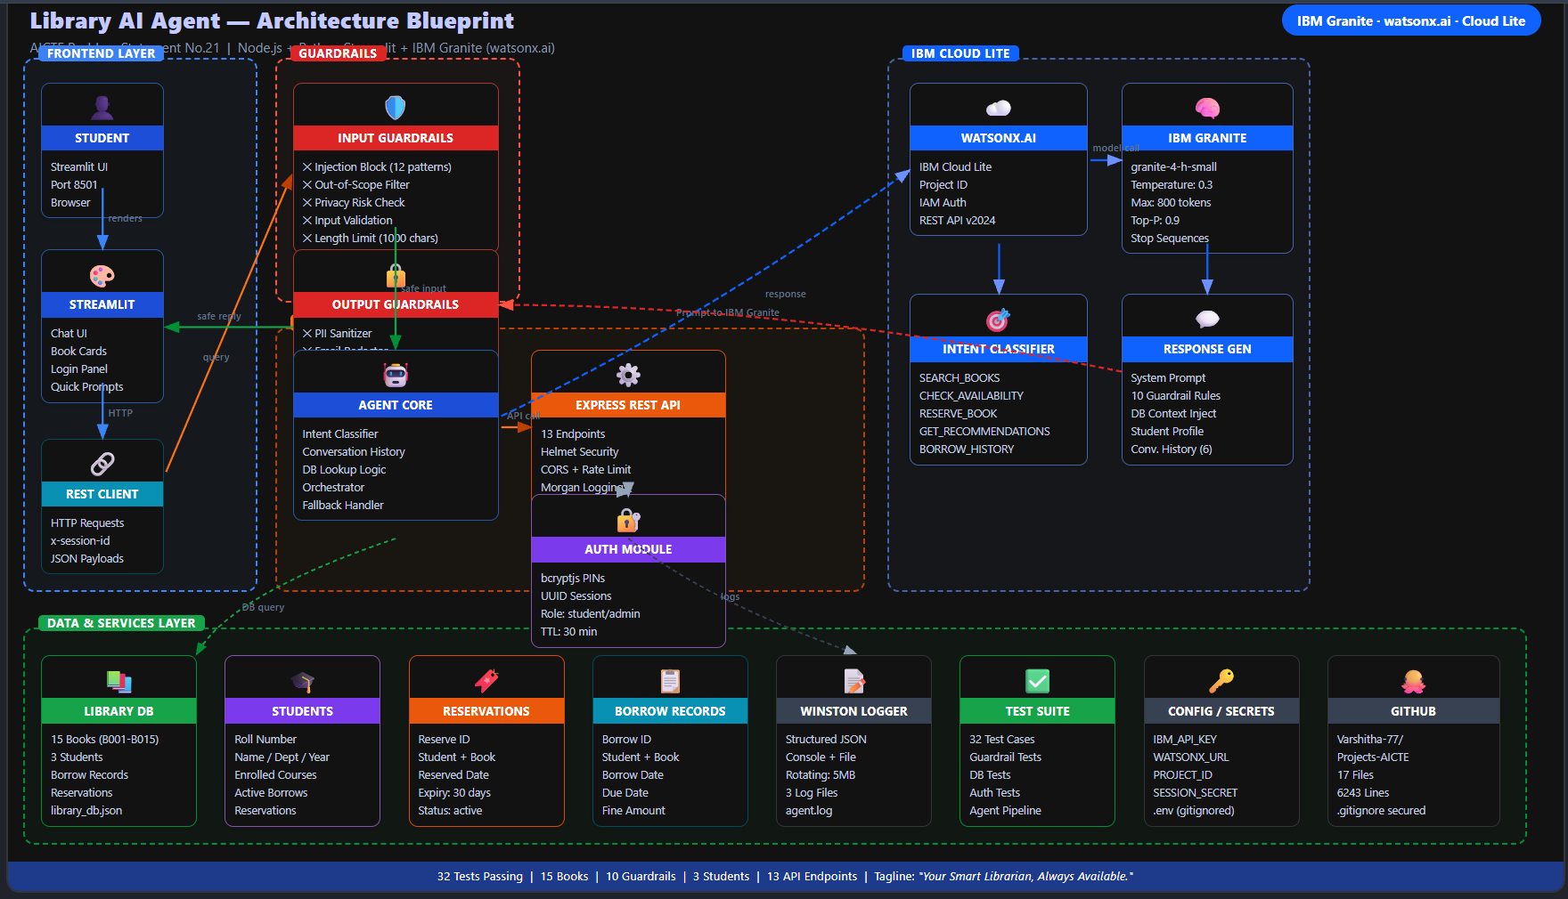
Architecture blueprint

Slide 7

Role of Agentic AI in the solution
Agentic AI turns the Library AI Agent into an intelligent, autonomous system rather than a simple chatbot. Using **IBM Granite models**, it understands what a student really needs and follows a perceive → reason → act → respond cycle, with safety checks, authentication and database lookups before every reply.
Each agent step has a clear job, such as classifying intent, searching books, checking live availability, creating reservations and showing borrow history. These are real database actions, so students get verified facts instead of invented titles.
Agentic AI also brings context awareness, using the student's department, year and enrolled courses to give personalized recommendations. It supports conversational memory of the last 6 turns, so follow-ups like "reserve the second one" are understood. Additionally, it acts **autonomously**, offering a reservation when a book is unavailable and widening vague searches before declaring no results.
Overall, Agentic AI makes the system proactive, personalized and action-oriented, acting like a smart digital librarian that helps students find and reserve books with ease.

Slide 8
Novelty and Uniqueness
The proposed Library AI Agent stands out by combining Agentic AI, grounded retrieval, and personalization into a single intelligent system.
Guardrail-First Design – Safety checks run before and after every AI response, blocking prompt injection and stripping personal data before it reaches the student.
Zero-Hallucination Grounding – Live library database records are injected into every prompt, so the agent never invents book titles, authors, or availability.
Course-Aware Personalization – Recommendations are matched to each student's enrolled course codes, excluding books they have already borrowed.
True Agentic Actions – Creates real reservations, remembers conversation context, and offers a reservation automatically when a book is unavailable.
Dual-Mode Resilience – A keyword-based fallback keeps the agent running if the IBM API is unreachable, so students never see downtime.
This makes the solution a smart, secure, and proactive digital librarian, not just a book search tool.

Slide 9
Git Hub Link
Github URL –https://github.com/Varshitha-77/Projects-AICTE
·
·
·

Slide 10
Future Scope
1. Multilingual & Voice-Enabled Assistant –
Using IBM Granite multilingual models and Watson Speech-to-Text, students can search for books by speaking in their own language. This improves accessibility for all students, including the visually impaired, and makes the system suitable for colleges with diverse linguistic backgrounds.
2. RAG, Syllabus Integration & Smart Notifications –
Connecting the agent to book summaries and uploaded syllabi enables chapter-level study help and recommendations aligned to upcoming course topics. Email and WhatsApp alerts for due dates, reservations, and new arrivals keep students informed and engaged.
·
·
·

Slide 11
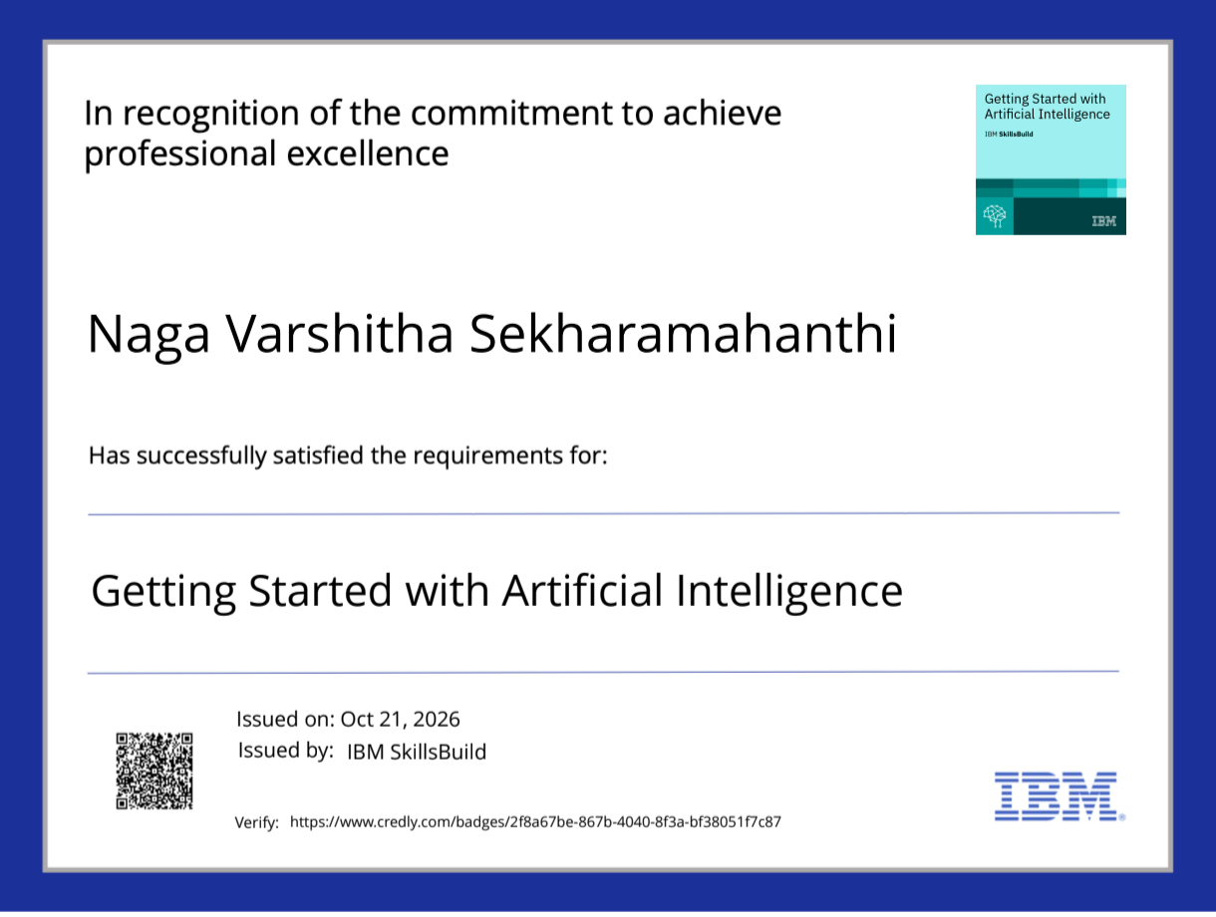
Certificates Earned:

Slide 12
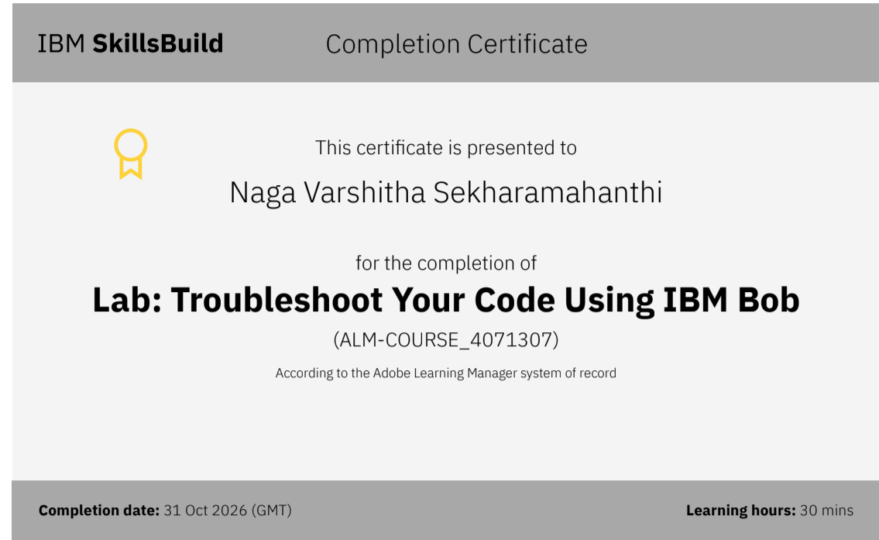
Certificates Earned:​

Slide 13


